Slide 1
Structured Query Language
• structure definition & modification
• queries (retrievals)
• updating: insert, delete, modify values

Slide 2
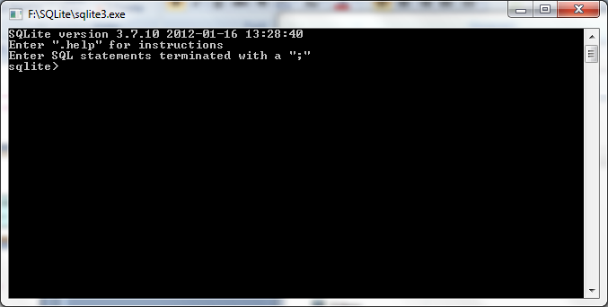
Run sqlite
sqlite> ready for SQL commands, or
sqlite> special commands.
sqlite>
- - - - > waiting for a ‘;’ to terminate an SQL command
sqlite>
sqlite>.quit closes sqlite

Slide 3
Basic Data Types
integer
real
text
numeric (for boolean, date, etc.)

Slide 5
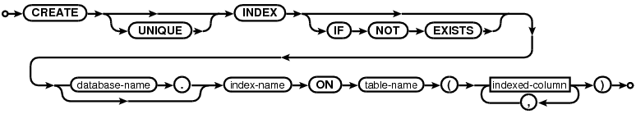

create-index-stmt:
indexed-column:
©Stefan Stanczyk U08049 - 2008

Slide 6
• alter table table-name
{add (attribute specification as in the create statement) |
modify attribute-name [data-type] [default expression] [column-constraint] |
drop
{primary key [cascade] |
unique (attribute-names) |
constraint constraint-name}}
©Stefan Stanczyk U08049 - 2008

Slide 7
MODULE
PREQ
REGISTER
STUDENT
©Stefan Stanczyk U08049 - 2008

Slide 8
SQL> create table MODULE
2 ( CODE varchar2(4) primary key,
3 TITLE varchar2(15),
4 STATUS varchar2(1) constraint mod_val check (STATUS in ('B', 'A')),
5 CREDIT number(1) constraint mod_cred check (CREDIT in (1, 2)));
Table created.
SQL> desc MODULE
Name Null? Type
------------------------------- -------- ----
CODE NOT NULL VARCHAR2(4)
TITLE VARCHAR2(15)
STATUS VARCHAR2(1)
CREDIT NUMBER(1)
SQL>insert into MODULE values ('&code', '&title', '&status', &credit);
Enter value for code: 8001
Enter value for title: Comp Systems
Enter value for status: B
Enter value for credit: 1
old 1: insert into MODULE values ('&code', '&title', '&status', &credit)
new 1: insert into MODULE values ('8001', 'Comp Systems', 'B', 1)
......................................
SQL> set verify off -- to get rid of ... old ...new prompts
©Stefan Stanczyk U08049 - 2008

Slide 9
SQL>create table PREQ
2 (MCODE varchar2(4),
3 PCODE varchar2(4),
4 constraint pkey_is primary key (MCODE, PCODE),
5 constraint fkey1 foreign key (MCODE) references MODULE(CODE),
6 constraint fkey2 foreign key (PCODE) references MODULE(CODE));
Table created.
SQL> desc PREQ
Name Null? Type
------------------------------- -------- ----
MCODE NOT NULL VARCHAR2(4)
PCODE NOT NULL VARCHAR2(4)
©Stefan Stanczyk U08049 - 2008

Slide 10
SQL>create table STUDENT
2 (NAME varchar2(8) primary key,
3 SEX char(1) constraint sex_value check (SEX in ('M', 'F')),
4 FIELD varchar2(4) not null,
5 CITY varchar2(15),
6 ENTRY date);
Table created.
SQL> desc STUDENT
Name Null? Type
------------------------------- -------- ----
NAME NOT NULL VARCHAR2(8)
SEX CHAR(1)
FIELD NOT NULL VARCHAR2(4)
CITY VARCHAR2(15)
ENTRY DATE
©Stefan Stanczyk U08049 - 2008

Slide 11
SQL> create table REGISTER
2 ( MCODE varchar2(4),
3 SNAME varchar2(8),
4 MARK number(3) constraint mark_val check (MARK between 0 and 100),
5 constraint pkey_rg primary key (MCODE, SNAME),
6 constraint fkey_rg1 foreign key (MCODE) references MODULE (CODE),
7 constraint fkey_rg2 foreign key (SNAME) references STUDENT(NAME));
Table created.
SQL> desc REGISTER
Name Null? Type
-------------------------------
MCODE NOT NULL VARCHAR2(4)
SNAME NOT NULL VARCHAR2(8)
MARK NUMBER(3)
©Stefan Stanczyk U08049 - 2008

Slide 12
SQL> select * from PREQ;
MCOD PCOD
---- ----
8001 NONE
8002 NONE
8003 8001
8008 8003
8010 8008
8011 8008
8012 8011
8016 8011
8019 8606
8024 8606
.........
SQL> select * from MODULE;
CODE TITLE S CREDIT
---- --------------- - ----------
8001 Comp Systems B 1
8002 Intro Soft Eng B 1
8003 Programming 1 B 1
8008 Programming 2 B 1
8010 Software Design A 1
8011 Data Structures A 1
8012 OO Programming A 1
......................................
NONE RI complement B 1
SQL> select * from STUDENT;
NAME S FIEL CITY ENTRY
-------- - ---- --------------- ---------
John M CPS Oxford 27-SEP-97
Mary F COIF London 27-SEP-97
David M IFIN Glasgow 27-SEP-96
Anne F SH Oxford 27-SEP-97
Zoe F SH London 27-SEP-96
Brian M COIN Banbury 06-JAN-98
SQL> select * from REGISTER;
MCOD SNAME MARK
---- -------- ----------
8606 John 90
8606 Mary 90
8606 David 94
8606 Anne 92
8606 Zoe 67
8606 Brian 48
8001 John 78
8001 Mary 82
8001 David 67
............................
©Stefan Stanczyk U08049 - 2008

Slide 13
the content of OWNMARKS for Mary would be
SQL> select * from OWNMARKS;
MCOD SNAME MARK
---- -------- ----------
8606 John 90
8606 Mary 90
8606 David 94
8606 Anne 92
8606 Zoe 67
8606 Brian 48
8001 John 78
8001 Mary 82
8001 David 67
............................
create view OWNMARKS
as
select * from REGISTER
where STNAME = user;
©Stefan Stanczyk U08049 - 2008

Slide 14
SQL> select * from ML8606;
MCOD SNAME MARK
---- -------- ----------
8606 John 90
8606 Mary 90
8606 David 94
8606 Anne 92
8606 Zoe 67
8606 Brian 48
8001 John 78
8001 Mary 82
8001 David 67
............................
create view ML8606
as
select * from REGISTER
where MCODE = 8606;
©Stefan Stanczyk U08049 - 2008

Slide 15
select
[
distinct
]
target-list
from
tablename [, tablename]*
[
where
predicate]
[
group by
attribute-name [,atribute-name]*
[
having
function-list]]
[order by
attribute-name [
desc
] [,atribute-name [
desc
]]*
©Stefan Stanczyk U08049 - 2008

Slide 16
What are the different modules stored in the College Database?
select distinct CODE, TITLE from MODULE;
Π MODULE(CODE, TITLE)
Which modules require module 8049 as a prerequisite?
select * from MODULE where REQUIRES= 8049;
σ MODULE(REQUIRES= 8049).
©Stefan Stanczyk U08049 - 2008

Slide 17
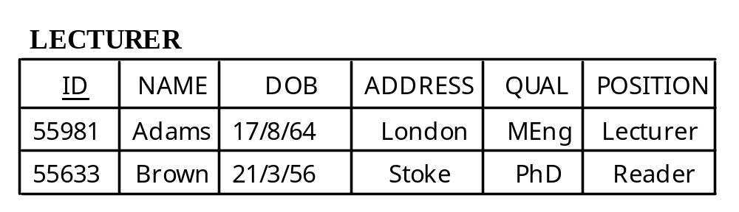
select ID, NAME from LECTURER
where (ADDRESS = 'Oxford' or ADDRESS = 'Abingdon')
and DOB between '01-Mar-55' and '01-Mar-60'
and QUAL like '%Eng%'
and POSITION in ('Senior Lecturer', 'Reader’);
©Stefan Stanczyk U08049 - 2008

Slide 18
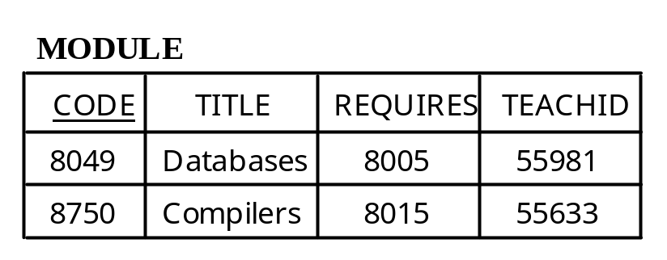
Get the lecturer identifiers and names together
with the titles of the modules they teach
select ID, NAME, TITLE
from LECTURER, MODULE
where LECTURER.ID = MODULE.TEACHID;
join LECTURER, MODULE: (ID = TEACHID)
©Stefan Stanczyk U08049 - 2008

Slide 19
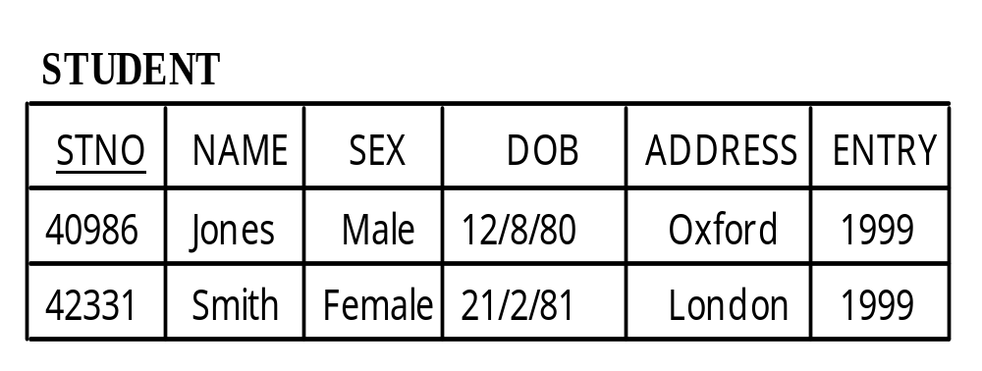
X
Y
Get the list of all pairs of students who have the same name
select X.STNO, X.NAME, Y.STNO, Y.NAME
from STUDENT X, STUDENT Y
where X.NAME = Y.NAME and X.STNO < Y.STNO;
©Stefan Stanczyk U08049 - 2008

Slide 20
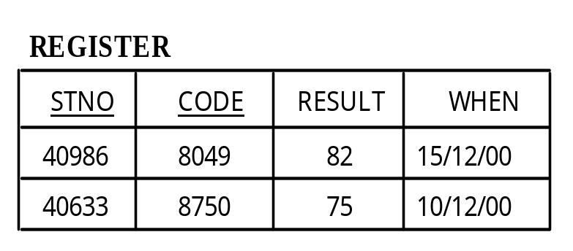
select STUDENT.STNO, STUDENT.NAME, RESULT
from STUDENT, MODULE, REGISTER
where MODULE.CODE = REGISTER.CODE
and REGISTER.STNO = STUDENT.STNO
and RESULT is not null
order by STUDENT.NAME;
©Stefan Stanczyk U08049 - 2008

Slide 21
For a given student name, list all the module codes and the
corresponding examination results obtained by that student
select CODE, RESULT
from REGISTER
where STNO =
(select STNO
from STUDENT
where NAME = 'Jones')
©Stefan Stanczyk U08049 - 2008

Slide 22
relational assignment
create table BASIC_MODULE (CODE, NAME)
as
select CODE, TITLE
from MODULE
where REQUIRES is null;
©Stefan Stanczyk U08049 - 2008

Slide 23
!!
tables: MODULE, STUDENT, PREQ, REGISTER
are accessible on ORACLE (cs3) via public synonyms:
MODULE49, STUDENT49, PREQ49 , REGISTER49.
to create your own versions of these tables
follow the schema:
create table STUDENT as select * from STUDENT49;
!!
©Stefan Stanczyk U08049 - 2008

Slide 24
delete
from
tablename
[
where
predicate]
insert
into
tablename [(attribute-name [, attribute-name]*)]
{
values
(value [,value]*) | query}
update
table-name [correlation variable]
set
attribute-name = attribute-expr
[, attribute-name = attribute-expr]*
([attribute-name [, attribute-name]*) = query
[
where
predicate]
©Stefan Stanczyk U08049 - 2008

Slide 25
Delete all the exam results for the two years immediately preceding a given date
delete from REGISTER
where WHEN + 730 < given date;
Delete all the students who are not registered for any module
delete from STUDENT
where STNO not in
(select distinct STNO from REGISTER) ;
©Stefan Stanczyk U08049 - 2008

Slide 26
Add a new module on database software to MODULE
insert into MODULE
values ( 8027, 'DB Software', 8049, 55981);
Copy all the entries from REGISTER that contain excellent
results in whatever subject into another table
insert into WHIZZ (STNO, CODE, GRADE)
select STNO, CODE, RESULT
from REGISTER where RESULT > 85;
Update details of a given lecturer
update LECTURER
set QUAL = 'PhD', POSITION = 'SnrLecturer’
where ID = 55981;
©Stefan Stanczyk U08049 - 2008

Slide 27
select STNO, RESULT
from REGISTER, MODULE
where REGISTER.CODE = MODULE.CODE
and TITLE like ‘%Data%’
and RESULT < 40;
select STNO, RESULT
from REGISTER, MODULE
where REGISTER.CODE = MODULE.CODE
and TITLE like ‘%prog%’
and RESULT < 40;
select STNO, RESULT
from REGISTER, MODULE
where REGISTER.CODE = MODULE.CODE
and TITLE like &module
and RESULT < &&mark;
©Stefan Stanczyk U08049 - 2008

Slide 28
poor-result-query.sql
set verify off
accept module char prompt ‘Enter subject :’
accept mark number prompt ‘Enter mark :’
select STNO, RESULT
from REGISTER, MODULE
where REGISTER.CODE = MODULE.CODE
and TITLE like &module
and RESULT < &&mark;
SQL> start poor-result-query
©Stefan Stanczyk U08049 - 2008

Slide 29
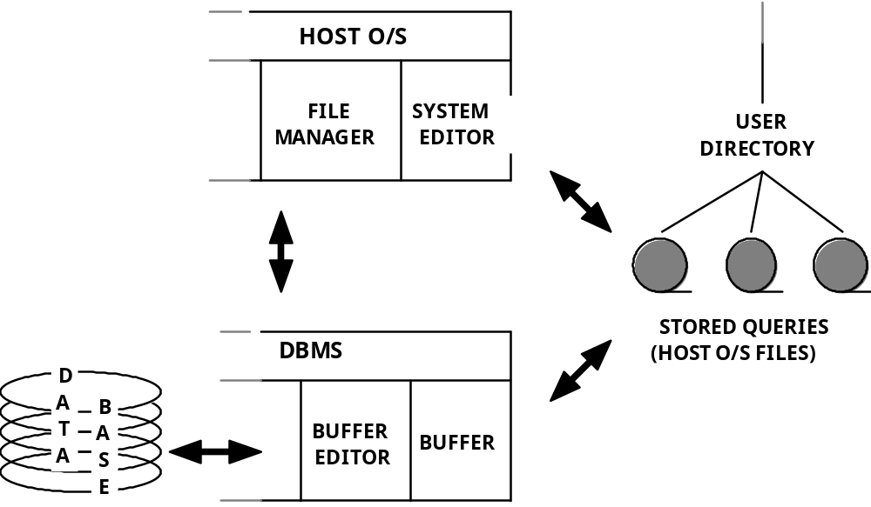
save filename.sql buffer to file
get filename.sql file to buffer
/ run buffer
©Stefan Stanczyk U08049 - 2008

Slide 30
SQL> host pico poor-result-query.sql
UW PICO(tm) 3.9 File: poor-results-query.sql
set verify off
accept module char prompt ‘Enter subject :’
accept mark1 number prompt ‘Enter mark :’
accept mark2 number prompt ‘Enter mark :’
select STNO, RESULT
from REGISTER, MODULE
where REGISTER.CODE = MODULE.CODE
and TITLE like &module
and RESULT < &&mark1
and RESULT > && mark2;
[ Read 12 lines ]
^G Get Help ^O WriteOut ^R Read File ^Y Prev Pg ^K Cut Text ^C Cur Pos
^X Exit ^J Justify ^W Where is ^V Next Pg ^U UnCut Text^T To Spell
SQL> …
©Stefan Stanczyk U08049 - 2008

Slide 31
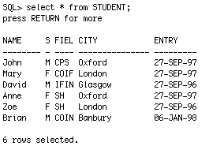
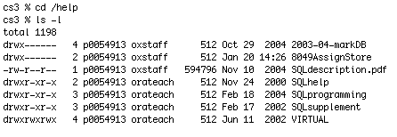

cs3 process 1
Unix
cs3 process 2
SQL
local - e.g. editing .sql files
browser
rem Results of SH-students on 8049
select NAME, MARK
from STUDENT, REGISTER
where FIELD = ‘&x’ and MCODE = ‘&y’
and NAME = SNAME;
WORKSTATION
©Stefan Stanczyk U08049 - 2008

